Slide 1
RUSTikales Rust for beginners

Slide 2
Plan for today

Slide 3
Plan for today
Recap

Slide 4
Plan for today
Recap
Function Calls

Slide 5
Recap
Primitive Types in Rust: i8, u8, ..., i128, u128, bool, f32, f64

Slide 6
Recap
Primitive Types in Rust: i8, u8, ..., i128, u128, bool, f32, f64
Ownership-Model
References
Borrow Checker

Slide 7
Recap
Primitive Types in Rust: i8, u8, ..., i128, u128, bool, f32, f64
Ownership-Model
References
Borrow Checker
Lifetimes
Every reference has a lifetime
Reference must be valid between creation and usage
Value it points to must be alive
Used by the Borrow Checker

Slide 8
Recap
Primitive Types in Rust: i8, u8, ..., i128, u128, bool, f32, f64
Ownership-Model
References
Borrow Checker
Lifetimes
Functions are declared using the keyword fn
Functions can accept parameters
Functions can return values

Slide 9
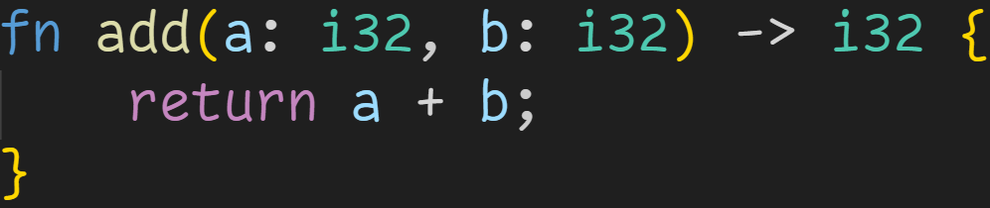
Recap

Slide 10
Recap
Parameters

Slide 11
Recap
Return Type

Slide 12
Recap
return statement
→ Must return a value of the specified type

Slide 13
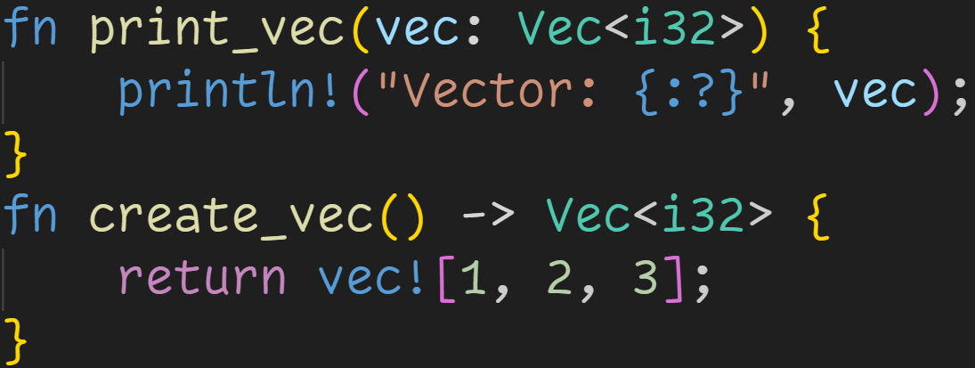
Recap

Slide 14
Recap
Return Type is optional

Slide 15
Recap
Parameters are optional

Slide 16
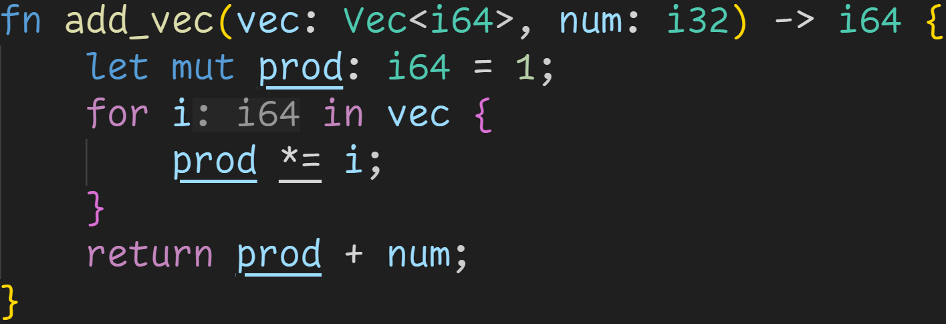
Recap
1/3

Slide 17
Recap
1/3
Does this function compile?

Slide 18
Recap
1/3
Does this function compile?
prod is i64

Slide 19
Recap
1/3
Does this function compile?
prod is i64
num is i32

Slide 20
Recap
1/3
Does this function compile?
prod is i64
num is i32
→ i64 + i32 is not defined

Slide 21
Function Calls

Slide 22
Function Calls
Function calls are expressions

Slide 23
Function Calls
Function calls are expressions
Functions are called by writing their name, followed by arguments in parenthesis

Slide 24
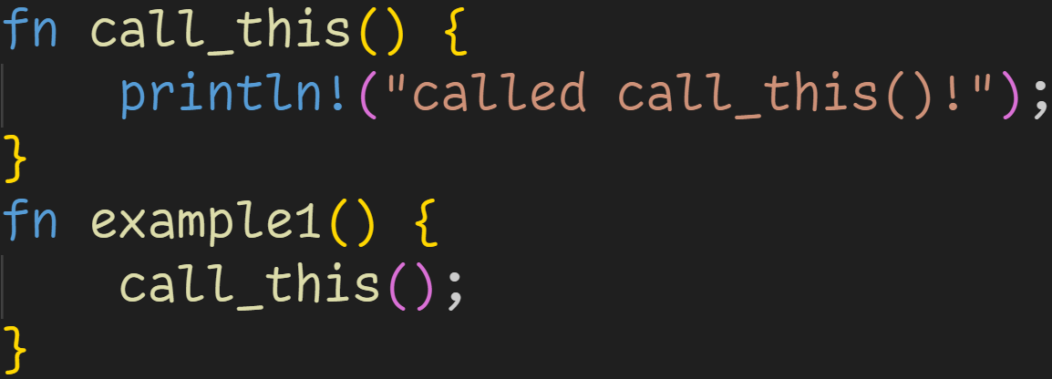
Function Calls

Slide 25
Function Calls
Function declaration

Slide 26
Function Calls
Function call

Slide 27
Function Calls
For every parameter, we have to provide an argument
→ call_this has no parameters, so don‘t need to provide anything

Slide 28
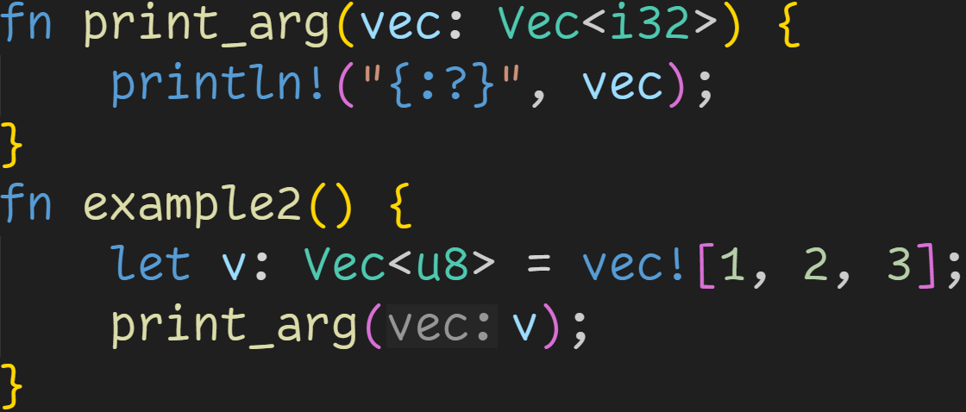
Function Calls

Slide 29
Function Calls
Every argument has to have the same type as the matching parameter

Slide 30
Function Calls
Type doesn‘t match
→ Compiler error
Every argument has to have the same type as the matching parameter

Slide 31
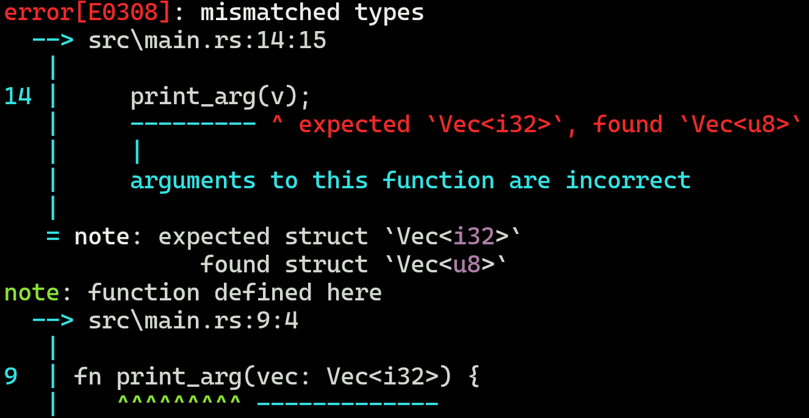

Function Calls

Slide 32
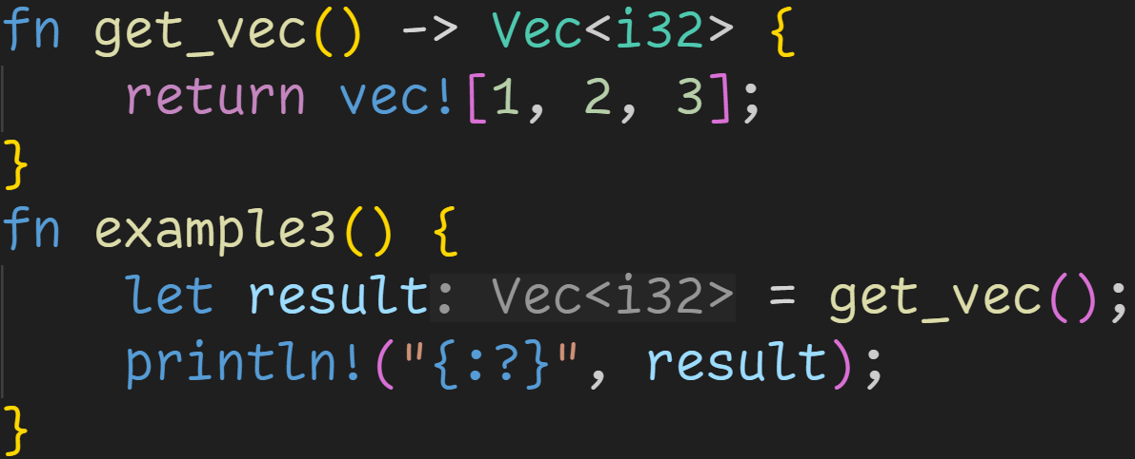
Function Calls

Slide 33
Function Calls
Return value can be used here

Slide 34
Function Calls
result in example3 has this value after the function call

Slide 35

Function Calls
result in example3 has this value after the function call

Slide 36
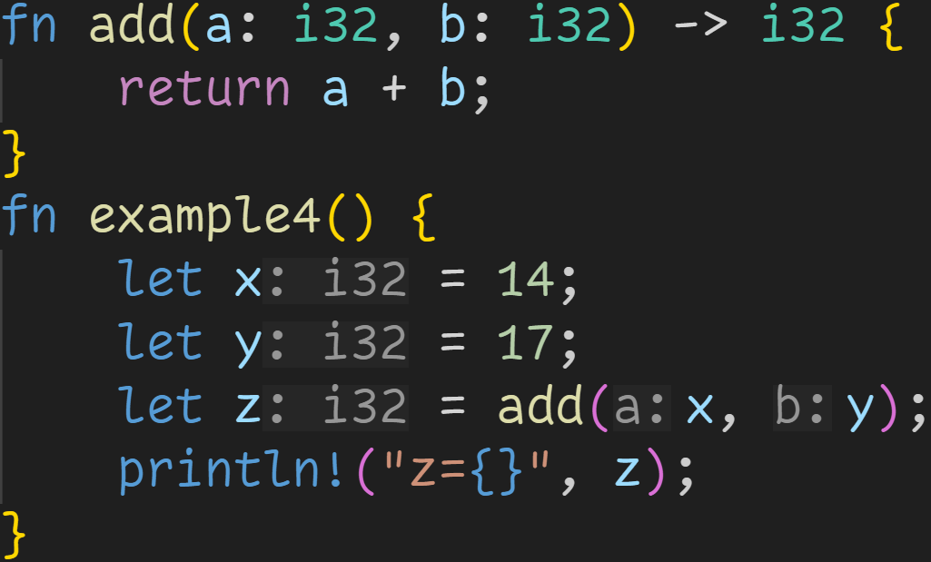
Function Calls

Slide 37
Function Calls
Function declared to take 2 parameters

Slide 38
Function Calls
Function declared to take 2 parameters
→ Function takes 2 arguments

Slide 39
Function Calls
Function declared to take 2 parameters
→ Function takes 2 arguments
Function declared to return i32

Slide 40
Function Calls
Function declared to take 2 parameters
→ Function takes 2 arguments
Function declared to return i32
→ add(x, y) evaluates to an i32

Slide 41
Function Calls
Function declared to take 2 parameters
→ Function takes 2 arguments
Function declared to return i32
→ add(x, y) evaluates to an i32
→ z is of type i32

Slide 42

Function Calls
Function declared to take 2 parameters
→ Function takes 2 arguments
Function declared to return i32
→ add(x, y) evaluates to an i32
→ z is of type i32
Code compiles, and prints 31

Slide 43
Intermission - Control Flow, again
But how does this work?
How does a know the value of x?
How does b know the value of y?
How does z know the return value?

Slide 44
Intermission - Control Flow, again
To understand this, we need to revisit memory

Slide 45
Intermission - Control Flow, again
To understand this, we need to revisit memory → Instructions are stored in memory

Slide 46
Intermission - Control Flow, again
To understand this, we need to revisit memory → Instructions are stored in memory → Whenever the computer sees a function, it jumps there, and executes that code

Slide 47
Intermission - Control Flow, again
To understand this, we need to revisit memory → Instructions are stored in memory → Whenever the computer sees a function, it jumps there, and executes that code → Variables and parameters are stored on the stack

Slide 48
Intermission - Control Flow, again
To understand this, we need to revisit memory → Instructions are stored in memory → Whenever the computer sees a function, it jumps there, and executes that code → Variables and parameters are stored on the stack → Every function allocates its own stack region, and frees it when you leave

Slide 49
Intermission - Control Flow, again
Stack

Slide 50
Intermission - Control Flow, again
Stack
x | ???
y | ???
z | ???

Slide 51
Intermission - Control Flow, again
Stack
x | 14
y | ???
z | ???

Slide 52
Intermission - Control Flow, again
Stack
x | 14
y | 17
z | ???

Slide 53
Intermission - Control Flow, again
Stack
x | 14
y | 17
z | ???
We want to jump to add, but we need to pass the arguments.
But we can‘t assign to a and b yet, they don‘t exist in memory!

Slide 54
Intermission - Control Flow, again
Stack
x | 14
y | 17
z | ???
We want to jump to add, but we need to pass the arguments.
But we can‘t assign to a and b yet, they don‘t exist in memory!
Solution: Our computer has temporary registers
Register 1 | ???
Register 2 | ???

Slide 55
Intermission - Control Flow, again
Stack
x | 14
y | 17
z | ???
We want to jump to add, but we need to pass the arguments.
But we can‘t assign to a and b yet, they don‘t exist in memory!
Solution: Our computer has temporary registers
Register 1 | 14
Register 2 | ???

Slide 56
Intermission - Control Flow, again
Stack
x | 14
y | 17
z | ???
We want to jump to add, but we need to pass the arguments.
But we can‘t assign to a and b yet, they don‘t exist in memory!
Solution: Our computer has temporary registers
Register 1 | 14
Register 2 | 17

Slide 57
Intermission - Control Flow, again
Stack
x | 14
y | 17
z | ???
We can now call the function
Register 1 | 14
Register 2 | 17

Slide 58
Intermission - Control Flow, again
Stack
x | 14
y | 17
z | ???
a | ???
b | ???
Register 1 | 14
Register 2 | 17

Slide 59
Intermission - Control Flow, again
Stack
x | 14
y | 17
z | ???
a | ???
b | ???
We can now move the arguments into the variables
Register 1 | 14
Register 2 | 17

Slide 60
Intermission - Control Flow, again
Stack
x | 14
y | 17
z | ???
a | 14
b | ???
We can now move the arguments into the variables
Register 1 | 14
Register 2 | 17

Slide 61
Intermission - Control Flow, again
Stack
x | 14
y | 17
z | ???
a | 14
b | 17
We can now move the arguments into the variables
Register 1 | 14
Register 2 | 17

Slide 62
Intermission - Control Flow, again
Stack
x | 14
y | 17
z | ???
a | 14
b | 17
We can now move the arguments into the variables And execute the code in our function!
Register 1 | 14
Register 2 | 17

Slide 63
Intermission - Control Flow, again
Stack
x | 14
y | 17
z | ???
a | 14
b | 17
However, we don‘t know where we should store this result.
It may be z, it may be in a vector, we don‘t know!
Register 1 | 14
Register 2 | 17

Slide 64
Intermission - Control Flow, again
Stack
x | 14
y | 17
z | ???
a | 14
b | 17
However, we don‘t know where we should store this result.
It may be z, it may be in a vector, we don‘t know!
Solution: Store it in a register, and leave it to the caller
Register 1 | 31
Register 2 | 17

Slide 65
Intermission - Control Flow, again
Stack
x | 14
y | 17
z | ???
We return now, which means cleaning the stack
Register 1 | 31
Register 2 | 17

Slide 66
Intermission - Control Flow, again
Stack
x | 14
y | 17
z | ???
We now have the result in Register 1, which we can use
Register 1 | 31
Register 2 | 17

Slide 67
Intermission - Control Flow, again
Stack
x | 14
y | 17
z | 31
We now have the result in Register 1, which we can use → We move the value into z
Register 1 | 31
Register 2 | 17

Slide 68

Intermission - Control Flow, again
Stack
x | 14
y | 17
z | 31
Our program prints 31

Slide 69
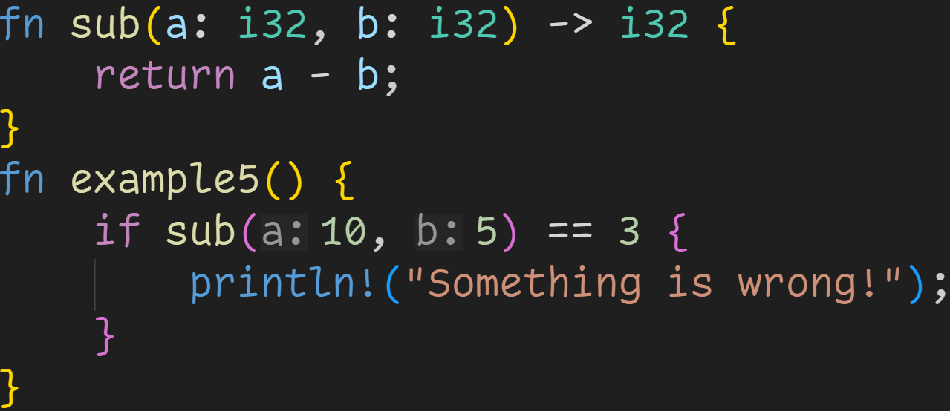
Function Calls

Slide 70
Function Calls
Functions are expressions, we can use them basically everywhere

Slide 71
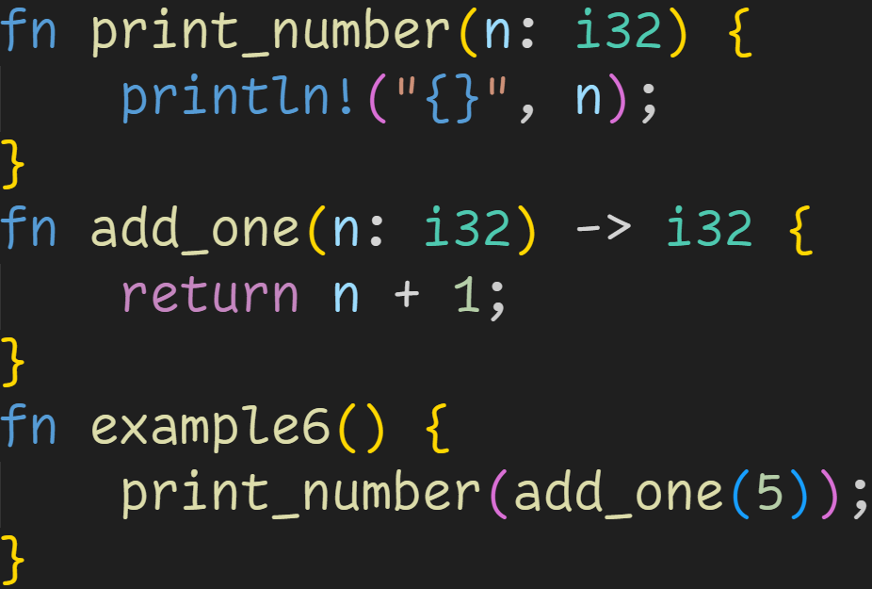
Function Calls

Slide 72
Function Calls
Including as arguments themselves!

Slide 73
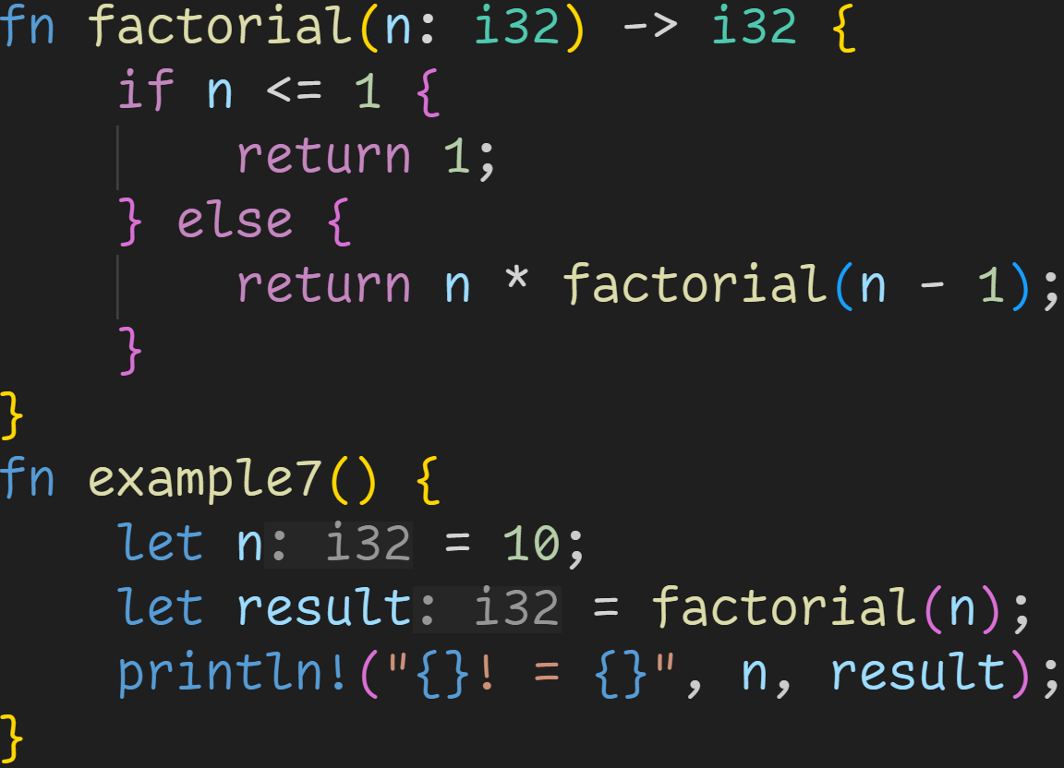
Function Calls

Slide 74
Function Calls
You can call a function in itself
→ Recursion

Slide 75
Function Calls
Stack

Slide 76
Function Calls
Stack
n | ???
result | ???
Registers
Ret | ???
Arg | ???

Slide 77
Function Calls
Stack
n | 10
result | ???
Registers
Ret | ???
Arg | ???

Slide 78
Function Calls
Stack
n | 10
result | ???
Registers
Ret | ???
Arg | 10

Slide 79
Function Calls
Stack
n | 10
result | ???
n | 10
Registers
Ret | ???
Arg | 10

Slide 80
Function Calls
Stack
n | 10
result | ???
n | 10
Registers
Ret | ???
Arg | 10
false

Slide 81
Function Calls
Stack
n | 10
result | ???
n | 10
Registers
Ret | ???
Arg | 10
false
Need to evaluate this expression before we can return a value

Slide 82
Function Calls
Stack
n | 10
result | ???
n | 10
Registers
Ret | ???
Arg | 9
false

Slide 83
Function Calls
Stack
n | 10
result | ???
n | 10
n | 9
Registers
Ret | ???
Arg | 9

Slide 84
Function Calls
Stack
n | 10
result | ???
n | 10
n | 9
Registers
Ret | ???
Arg | 9
Every time we call a function, we allocate new stack space
→ Every n we see here is in a different memory location! → Every function can only directly access its own stack space

Slide 85
Function Calls
Stack
n | 10
result | ???
n | 10
n | 9
Registers
Ret | ???
Arg | 8
false

Slide 86
Function Calls
Stack
n | 10
result | ???
n | 10
n | 9
n | 8
Registers
Ret | ???
Arg | 8

Slide 87
Function Calls
Stack
n | 10
result | ???
n | 10
n | 9
n | 8
Registers
Ret | ???
Arg | 7
false

Slide 88
Function Calls
Stack
n | 10
result | ???
n | 10
n | 9
n | 8
n | 7
Registers
Ret | ???
Arg | 7

Slide 89
Function Calls
Stack
n | 10
result | ???
n | 10
n | 9
n | 8
n | 7
n | 6
n | 5
n | 4
n | 3
n | 2
n | 1
Registers
Ret | ???
Arg | 1
Much later...

Slide 90
Function Calls
Stack
n | 10
result | ???
n | 10
n | 9
n | 8
n | 7
n | 6
n | 5
n | 4
n | 3
n | 2
n | 1
Registers
Ret | ???
Arg | 1
This is where the name Stack Overflow comes from:
→ Every time we call a recursive function, we allocate more memory → Memory is limited, we can easily allocate too much

Slide 91
Function Calls
Stack
n | 10
result | ???
n | 10
n | 9
n | 8
n | 7
n | 6
n | 5
n | 4
n | 3
n | 2
n | 1
Registers
Ret | 1
Arg | 1
true

Slide 92
Function Calls
Stack
n | 10
result | ???
n | 10
n | 9
n | 8
n | 7
n | 6
n | 5
n | 4
n | 3
n | 2
Registers
Ret | 1
Arg | 1
The computer keeps track of called functions
→ We can now go up the call chain and compute the result

Slide 93
Function Calls
Stack
n | 10
result | ???
n | 10
n | 9
n | 8
n | 7
n | 6
n | 5
n | 4
n | 3
Registers
Ret | 2
Arg | 1
The computer keeps track of called functions
→ We can now go up the call chain and compute the result

Slide 94
Function Calls
Stack
n | 10
result | ???
n | 10
n | 9
n | 8
n | 7
n | 6
n | 5
n | 4
Registers
Ret | 6
Arg | 1
The computer keeps track of called functions
→ We can now go up the call chain and compute the result

Slide 95
Function Calls
Stack
n | 10
result | ???
n | 10
n | 9
n | 8
n | 7
n | 6
n | 5
Registers
Ret | 24
Arg | 1
The computer keeps track of called functions
→ We can now go up the call chain and compute the result

Slide 96
Function Calls
Stack
n | 10
result | ???
n | 10
Registers
Ret | 362880
Arg | 1
Much later...
The computer keeps track of called functions
→ We can now go up the call chain and compute the result

Slide 97
Function Calls
Stack
n | 10
result | ???
Registers
Ret | 3628800
Arg | 1
We have now computed the result, which is located in the return register

Slide 98
Function Calls
Stack
n | 10
result | 3628800
Registers
Ret | 3628800
Arg | 1

Slide 99

Function Calls
Stack
n | 10
result | 3628800
Registers
Ret | 3628800
Arg | 1

Slide 100
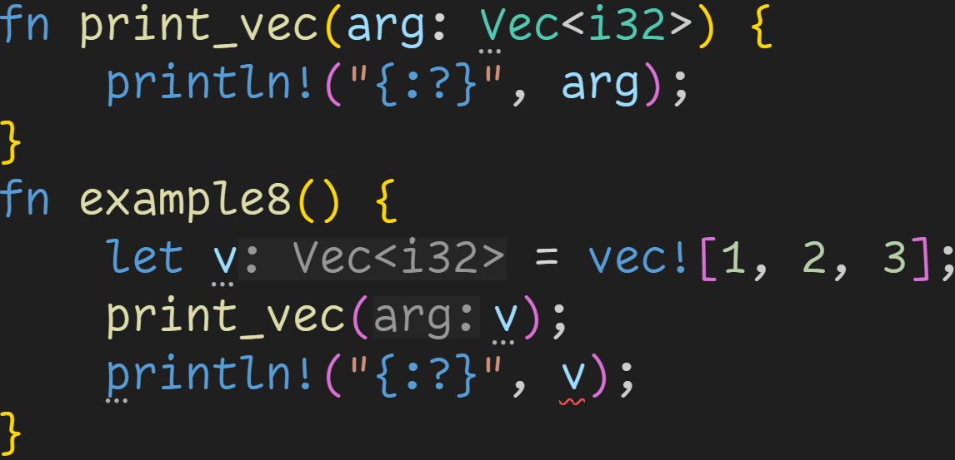
Function Calls

Slide 101
Function Calls
Normal Ownership rules apply → This vector is moved!

Slide 102
Function Calls
Not a reference

Slide 103

Function Calls
By borrowing values, you can still use the vector after the function call

Slide 104
Function Calls
Lifetime of &v

Slide 105
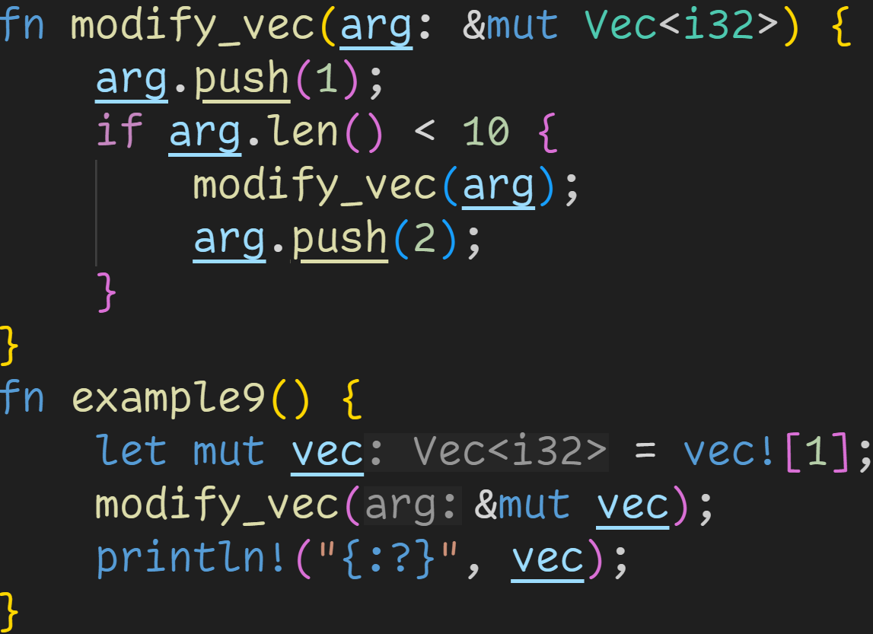
Function Calls

Slide 106
Function Calls
We can also pass mutable references

Slide 107
Function Calls
Lifetime of arg

Slide 108
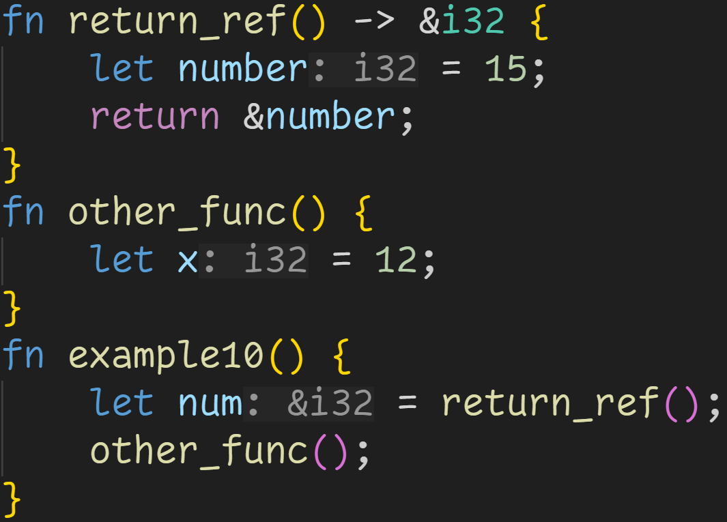
Function Calls

Slide 109
Function Calls
Returning references is only possible in special situations
→ This code will not compile

Slide 110
Function Calls
Addr | Stack
0x4000 | num | ???

Slide 111
Function Calls
Addr | Stack
0x4000 | num | ???

Slide 112
Function Calls
Addr | Stack
0x4000 | num | ???
0x4004 | number | ???

Slide 113
Function Calls
Addr | Stack
0x4000 | num | ???
0x4004 | number | 15

Slide 114
Function Calls
Register | 0x4004
Addr | Stack
0x4000 | num | ???
0x4004 | number | 15

Slide 115
Function Calls
Register | 0x4004
Addr | Stack
0x4000 | num | 0x4004

Slide 116
Function Calls
Register | 0x4004
Addr | Stack
0x4000 | num | 0x4004
The underlying value has been freed
→ Reference points to invalid memory!

Slide 117
Function Calls
Register | 0x4004
Addr | Stack
0x4000 | num | 0x4004

Slide 118
Function Calls
Register | 0x4004
Addr | Stack
0x4000 | num | 0x4004
0x4004 | x | 15

Slide 119
Function Calls
Register | 0x4004
Addr | Stack
0x4000 | num | 0x4004
0x4004 | x | 15
return_ref() just set this memory location to 15

Slide 120
Function Calls
Register | 0x4004
Addr | Stack
0x4000 | num | 0x4004
0x4004 | x | 12
return_ref() just set this memory location to 15
→ other_func overwrites the memory!

Slide 121
Function Calls
Register | 0x4004
Addr | Stack
0x4000 | num | 0x4004

Slide 122
Function Calls
Register | 0x4004
Addr | Stack
0x4000 | num | 0x4004
num still points to invalid memory!
We would now read a 12 instead of the 15 we wanted

Slide 123

Function Calls
Our code doesn‘t compile.

Slide 124
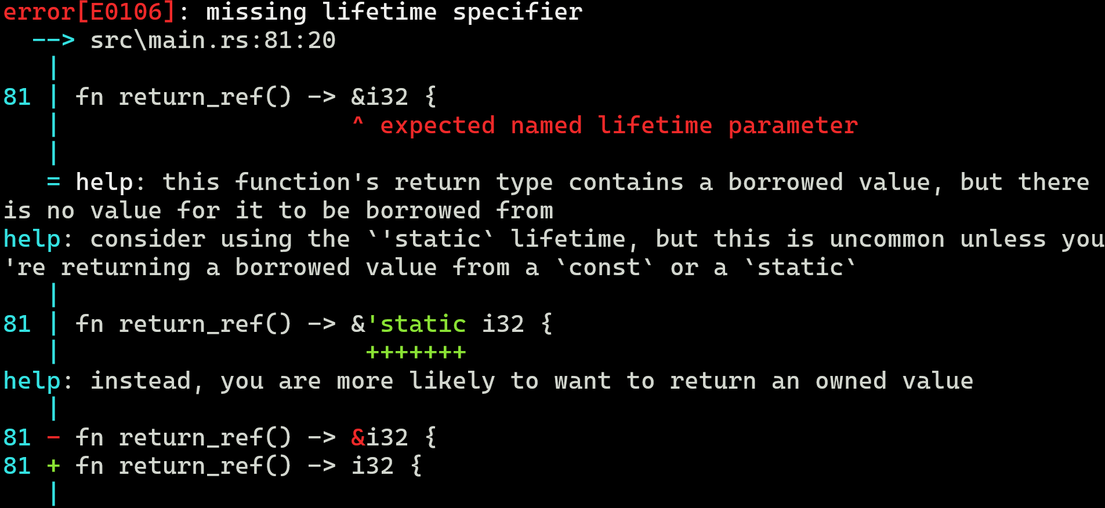
Function Calls
Our code doesn‘t compile.
This error is out of the scope of this beginners course, but the idea is:
→ We can only return references to values that outlive the function

Slide 125
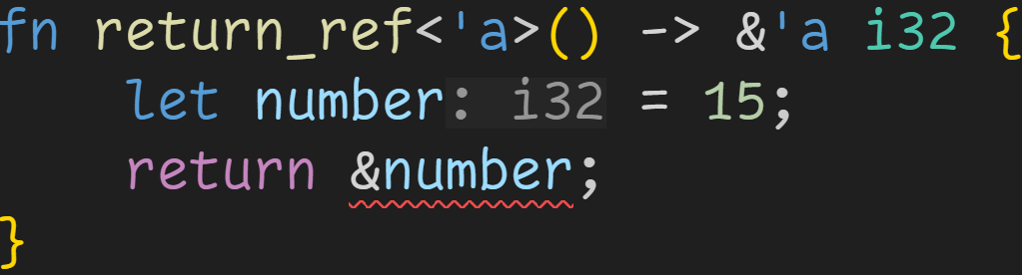
Function Calls
Error suggested providing a lifetime parameter, whatever that is

Slide 126
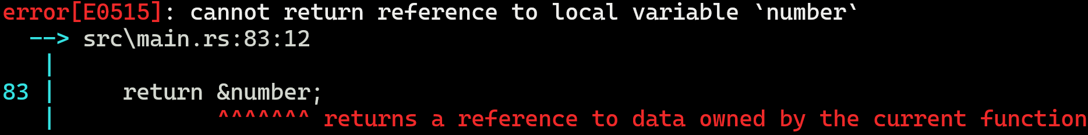
Function Calls
Error suggested providing a lifetime parameter, whatever that is
Error is easier to understand now :^) We can‘t outsmart the Borrow Checker

Slide 127
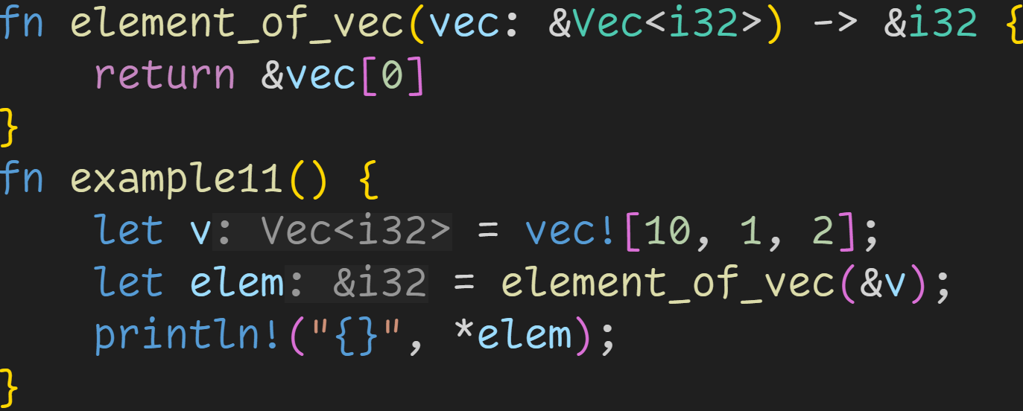
Function Calls

Slide 128
Function Calls
We can return a reference here

Slide 129
Function Calls
Lifetime elision: The return reference has the same lifetime as the parameter

Slide 130
Function Calls
elem points to the first element of v

Slide 131

Function Calls
elem points to the first element of v

Slide 132
Intermission - Exercises
Time for exercises!

Slide 133
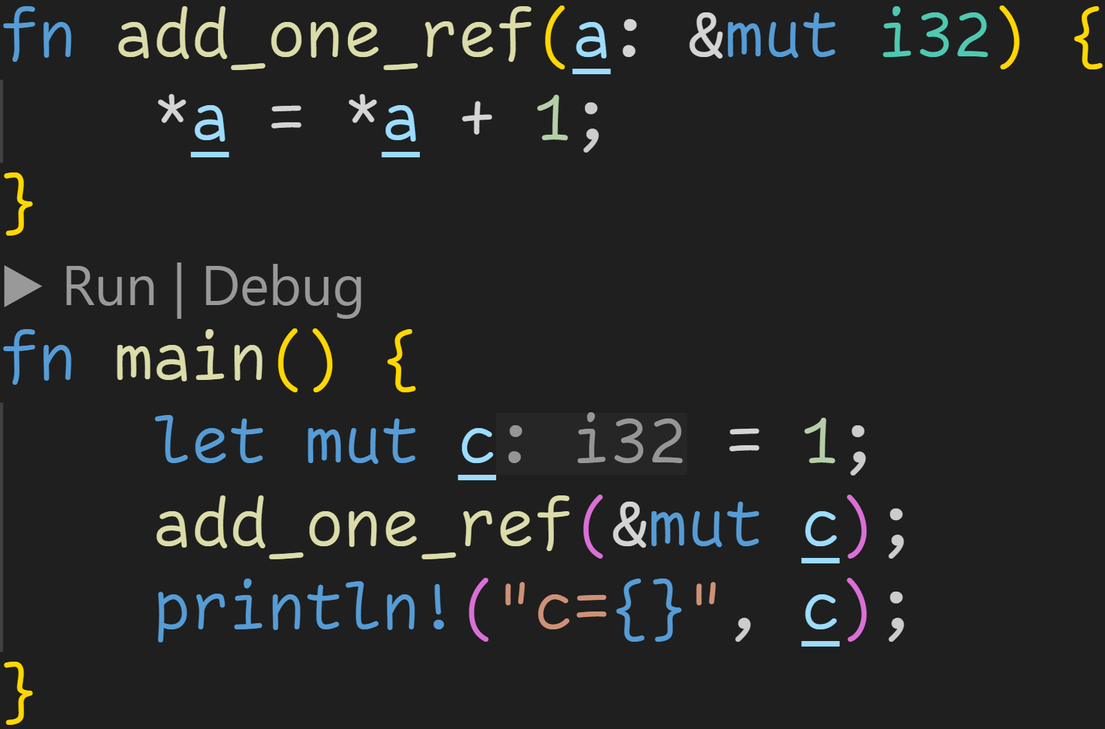
Intermission - Exercises
1/3

Slide 134
Intermission - Exercises
1/3
Does the code compile?
If yes, what does it print?

Slide 135
Intermission - Exercises
1/3
Does the code compile?
If yes, what does it print?
Yes, it does compile!

Slide 136
Intermission - Exercises
1/3
Does the code compile?
If yes, what does it print?
Yes, it does compile!
This line modifies the original c

Slide 137

Intermission - Exercises
1/3
Does the code compile?
If yes, what does it print?
Yes, it does compile!
This line modifies the original c

Slide 138
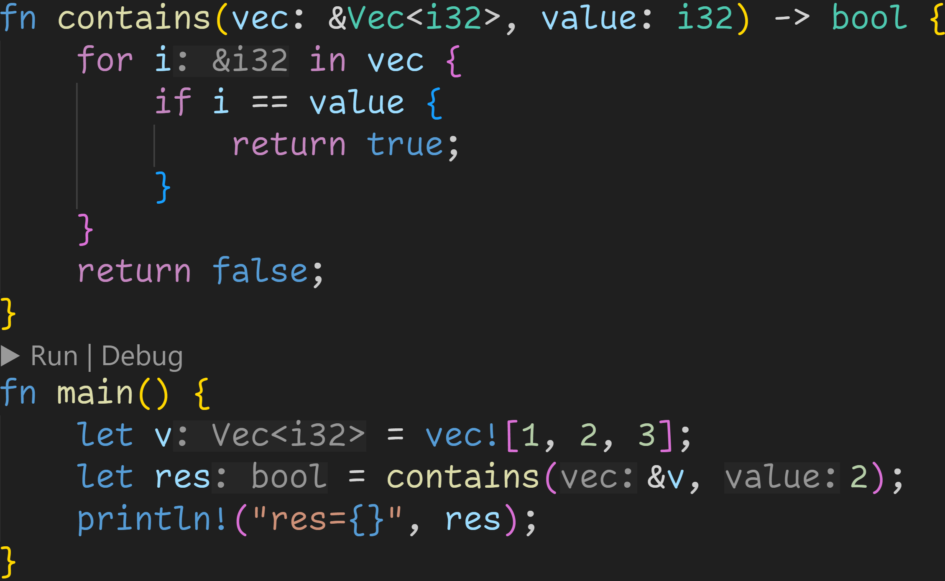
Intermission - Exercises
2/3

Slide 139
Intermission - Exercises
2/3
Does the code compile?
If yes, what does it print?

Slide 140
Intermission - Exercises
2/3
Does the code compile?
If yes, what does it print?
This code is almost perfect, there are no errors in the arguments or return values

Slide 141
Intermission - Exercises
2/3
Does the code compile?
If yes, what does it print?
BUT: &i32 == i32 is not defined :^)
The correct implementation would‘ve been *i == value
This code is almost perfect, there are no errors in the arguments or return values

Slide 142
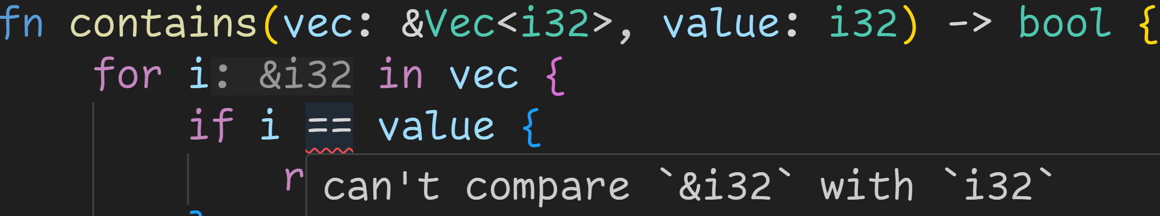
Intermission - Exercises
2/3
Does the code compile?
If yes, what does it print?

Slide 143
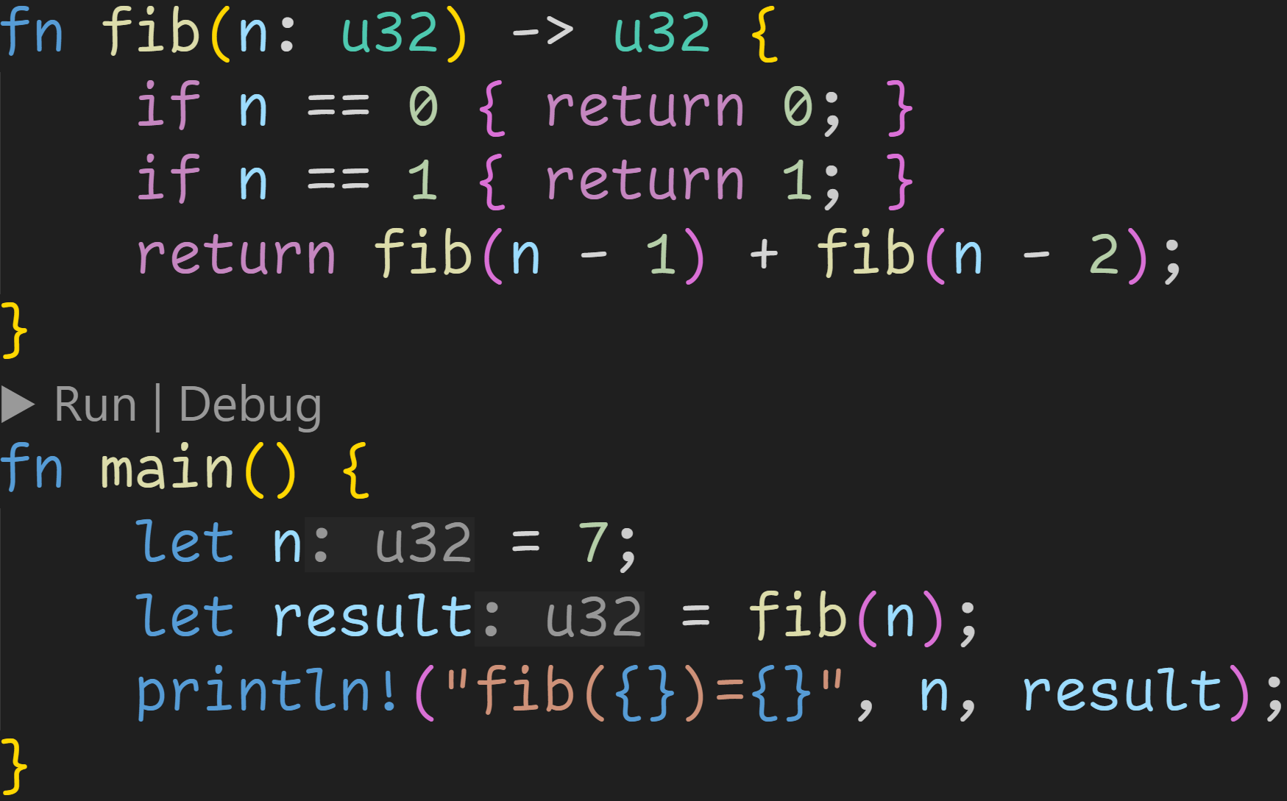
Intermission - Exercises
1/3

Slide 144
Intermission - Exercises
1/3
Does the code compile?
If yes, what does it print?

Slide 145
Intermission - Exercises
1/3
Does the code compile?
If yes, what does it print?
This code is very inefficient, but it gets the job done!
It compiles!

Slide 146

Intermission - Exercises
1/3
Does the code compile?
If yes, what does it print?
This code is very inefficient, but it gets the job done!
It compiles!
It successfully calculates fibonacci numbers, and prints:

Slide 147
Next time
Structs
Methods

